Slide 1

Representation of human – machine game problems as a search in a state space
Members
Cáceres Díaz, Renzo (11200004)
Escobar Villa, Andrés (6200075)
Gonzales Aburto, Ricardo (18200061)
Huamaní Avendaño, Dulce (18200219)
Molina Yupanqui, Flor (18200164)
Palomino Loa, Junior (18200172)
Quispe Vega, Anthony (18200179)
Vera León, Bryan (18200124)
Group 3

Slide 2

TABLE OF CONTENTS
01
02
EXAMPLE
STATE SPACES

Slide 3
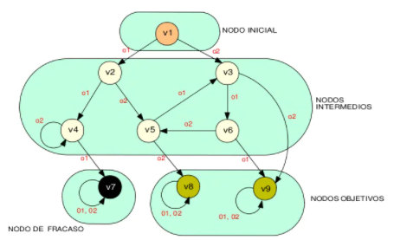
STATE SPACES
The state space of a game is a graph whose nodes represent achievable configurations (valid states) and whose arcs make explicit possible moves (state transitions). In principle, any state space can be constructed from the initial state, applying each of the rules to generate the immediate successors, and so on with each of the newly generated states (in practice, the state spaces are usually too large to make them fully explicit).
When a problem can be represented by a space of states, the computational solution corresponds to finding a path from the initial state to a target state.

Slide 4
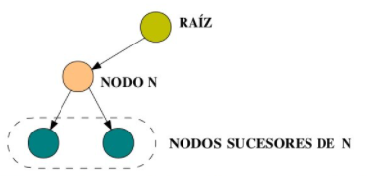
SEARCH TREES
The root of the tree corresponds to the initial state The expansion of a node is the process of finding its immediate successors. The successors of a node are called sons the target is a terminal node of the tree that is called a leaf

Slide 5
EXAMPLE OF STATE SPACES
DESCRIPTION OF THE PROBLEM
A muleteer stands on the edge of a river carrying a puma, a goat and a lettuce. You must cross to the other shore by means of a boat with capacity for two (the muleteer and some of his belongings). The difficulty is that if the puma is left alone with the goat it will devour it, and the same will happen if the goat is left alone with the lettuce. How to cross without losing any belongings?
REPRESENTATION OF THE CONFIGURATIONS OF THE UNIVERSE OF THE PROBLEM
The muleteer and each of his belongings have to be on one of the two banks. The representation of the state must then indicate on which side each of them is located. For this a symbolic term can be used with the following syntax: state(A,P,C,L), in which A, P, C and L are variables that represent, respectively, the position of the muleteer, the puma, the goat and the lettuce. The variables can take two values: i and d, which respectively symbolize the left edge and the right edge of the river. By convention it is chosen to split on the left edge. The initial state is then state(i,i,i,i). The target state is state(d,d,d,d).

Slide 6
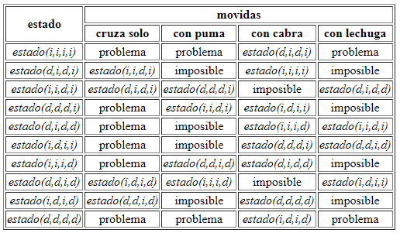
EXAMPLE OF STATE SPACES
DEFINITION OF TRANSITIONAL RULES The muleteer has four possible actions: crossing alone, crossing with the puma, crossing with the goat and crossing with the lettuce. These actions are conditioned to the fact that both passengers of the boat are on the same shore and that the puma with the goat or the goat with the lettuce are not left alone. The status resulting from an action is determined by exchanging the i and d values for the passengers of the boat.

